Slide 1
FRB Update #25
William Huang
(06/13/2021)

Slide 2
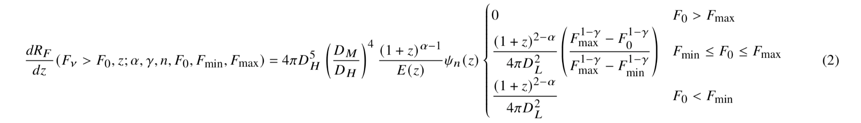
Brief Overview of Arcus Model
The key equation of Arcus et al.’s model is the following:
The first portion is related to how many events are per unit volume, which should increase as redshift increases, since there is more volume at larger distances.
The second portion, \psi_n(x), shows the proportionality to a certain power of the star formation rate.
The last portion, the cases of F_0 >= F_max, implements the observational limit: F_0 is the minimum fluence of the telescope, and F_max and F_min are the limits of the intrinsic FRB distribution.

Slide 3
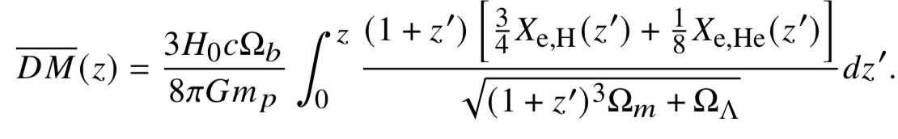
(continued)
They then convert this to the dispersion measure through the equation:
Which assumes a one-to-one relation of DM with z:

Slide 4
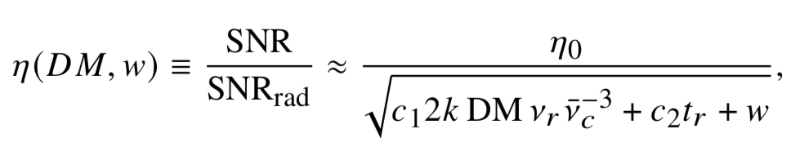
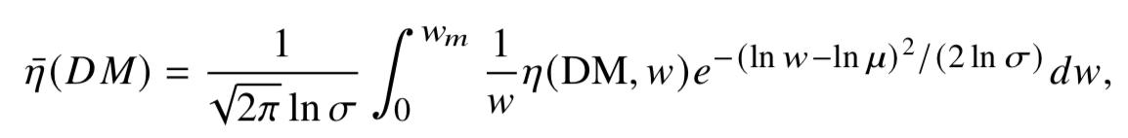
(continued)
Finally, the Arcus model multiplies the event rate dR/dDM, with the telescope efficiency in order to fit their model with the observed FRB counts. The efficiency is modelled as:
Note that the efficiency is averaged over different pulse widths assuming a log-normal distribution:

Slide 5

(continued)
The main variables in the model are:
Alpha, the spectral index:
Gamma, the energy power law index.
n, the exponent for how FRB rate is related to star formation rate
F_0, the limiting fluence of the telescope.
Alpha, Gamma, and F_0 affect only the orange boxed term, whereas n affects only the blue box.

Slide 6
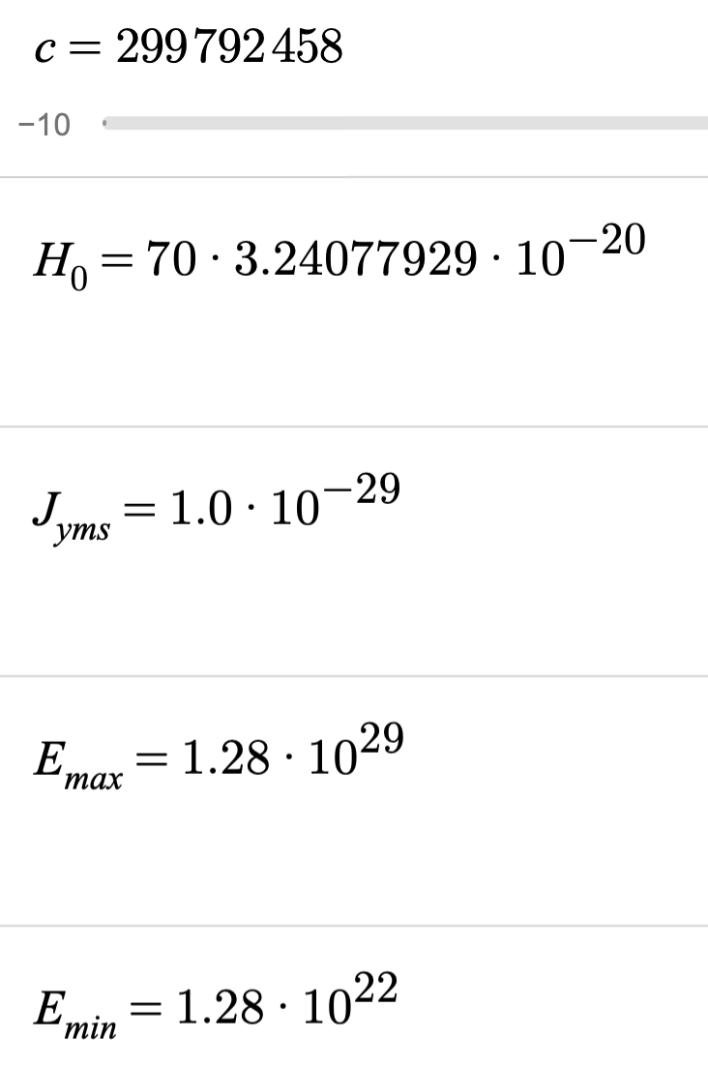
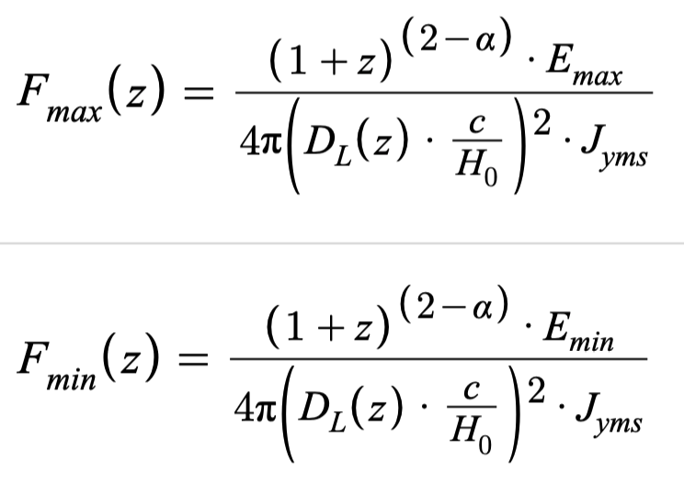
My Implementation
I used the constants on the left in my implementation, as well as the equations on the right to determine the inherent fluence limits of the FRB distribution based on the energy distribution. J_yms is the conversion factor between W/m^2 Hz and Jy ms.

Slide 7
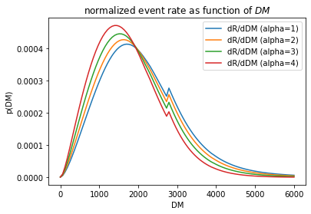
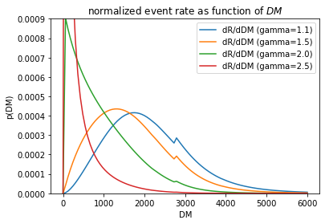
Exploration of Parameter Space
When increasing alpha (left), the distribution gets narrower and peaks at lower DM, which matches with the paper. Similarly, when increasing gamma (right), the distribution narrows and sharply increases. Since increasing both parameters corresponds to having fewer high energy FRBs, this makes sense.

Slide 8
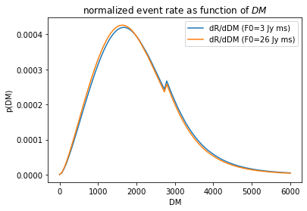
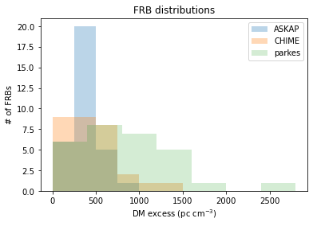
Problem with Fluence Limits
A problem with my implementation is that for F0 ~ 3 to 30 Jy ms, the distribution should decrease sharply at around 2000 DM (like in the data on the right and in the paper). I am working on fixing the implementation.
Model should decrease sharply after 2000 DM, but doesn’t
FRB data for each telescope

Slide 9
Conclusions
After investigating the Arcus model in depth, I have reached the following conclusions as to which features are important:
The efficiency of the telescope as a function of DM, as modelled by Arcus, does not have a significant effect on the shape of the distribution, so it should be able to be safely disregarded.
Using fluences and the DM(z) relation was very powerful in allowing the usage of more data.
Factors about the FRB energy distribution, like alpha and gamma, are influential in determining the FRB distribution.
I will continue debugging the Arcus model to see where it went wrong for the F_0 dependence, and additionally compare it to the Zhang et al. 2020 model for more insight.

